Slide 1
Introduction to
Electronics
Lecture 4 : Passive Components — Resistors & Capacitors
1

Slide 2
Learning Objectives
Identify common resistor types and read their value labels
Understand real resistor characteristics and selection criteria
Explain the functions of capacitors: energy storage, coupling, and decoupling
Calculate equivalent capacitance for series and parallel combinations
Apply the RC time constant to charging and discharging circuits
Define capacitive reactance and its frequency dependence
2

Slide 3
PART 1
Resistors in Practice
Types, functions, and how to read their values
3

Slide 4
Resistor Functions in Circuits
Resistors perform two basic functions: limit current flow and set voltage levels
Various kinds available: fixed, variable, digitally adjustable, fusible, photoresistors, and resistor arrays (networks)
Convert electrical energy into heat
Found in virtually every electronic circuit, from simple LED drivers to precision amplifiers
4

Slide 5
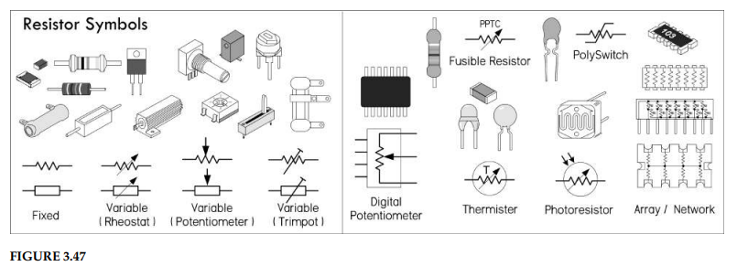
Resistor Types — Schematic Symbols
5

Slide 6
Current Limiting — The LED Example
Without a series resistor, excess current can melt an LED’s sensitive p-n junction
A resistor placed in series limits the current to a safe operating level
A variable resistor (potentiometer) can be added for adjustable current limiting
Adjusting the pot controls the LED brightness — a practical demonstration of Ohm’s Law
6

Slide 7
Voltage Division Application
Two resistors form a voltage divider, providing a fraction of the input voltage
Example: 12 V reduced to 5 V — a usable logic HIGH for a microcontroller input
A photoresistor can replace one divider resistor: as light increases, its resistance drops
The changing resistance shifts the output voltage, allowing light-level sensing
Recall from Lecture 2: Vout = Vs × R₂ / (R₁ + R₂)
7

Slide 8
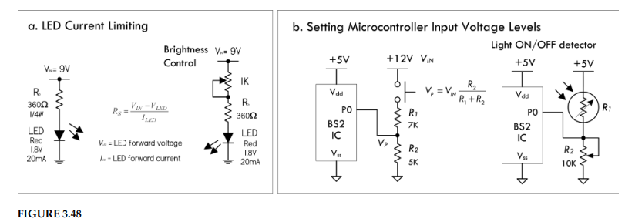
LED Current Limiting and Voltage Division (Fig. 3.48)
8

Slide 9
Wider Applications of Resistors
Setting operating current and signal levels in circuits
Providing voltage reduction and setting precise gain values
Acting as shunts in ammeters and voltage meters
Damping agents in oscillators and timer circuits
Bus and line terminators in digital circuits
Pull-up and pull-down elements, feedback networks, attenuators, and bridge circuits
Special fusible resistors serve as built-in fuses
9

Slide 10
Reading Resistor Labels — Color Codes
Axial-lead resistors (carbon composition, carbon film, metal film) use color bands
Four-band system: 1st = 1st digit, 2nd = 2nd digit, 3rd = multiplier (×10ⁿ), 4th = tolerance
No fourth band means ±20% tolerance
Each color maps to a digit (0–9), a multiplier, and a tolerance value
Example: Brown–Black–Red–Gold = 1, 0, ×10² = 1 kΩ ± 5%
10

Slide 11
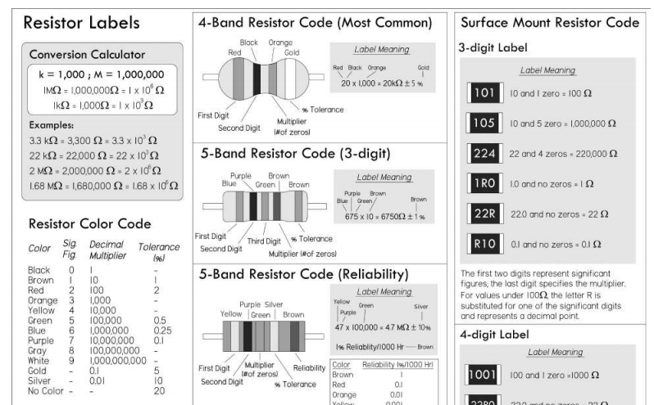
Resistor Labels — Complete Reference (Fig. 3.52)
11
FIGURE 3.52

Slide 12
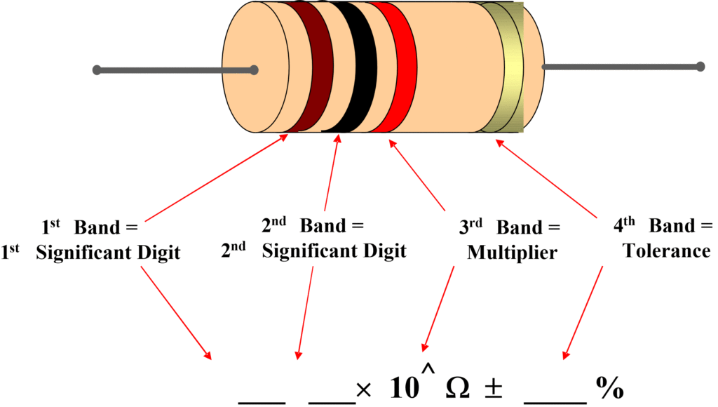
Four-Band Resistor Color Code
12

Slide 13
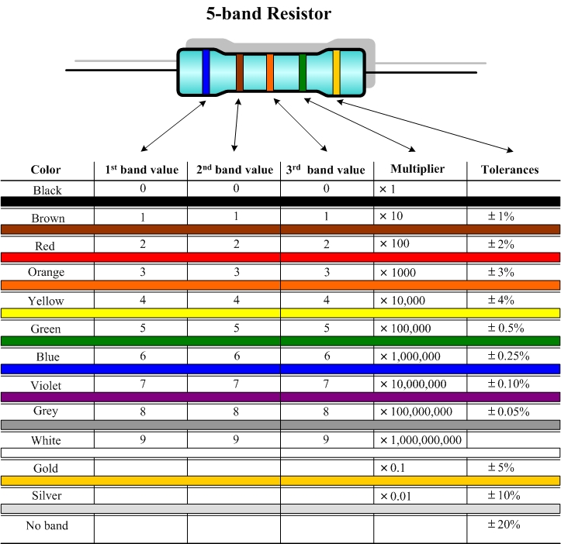
Resistor Color Code — Band Examples
13

Slide 14
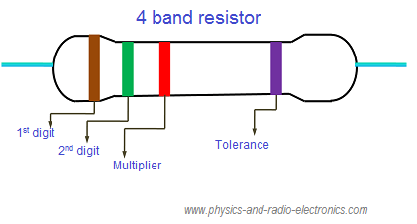
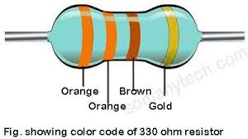
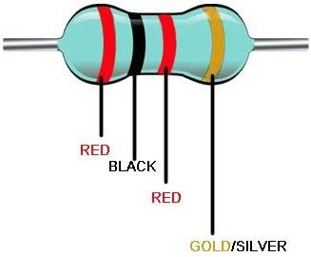
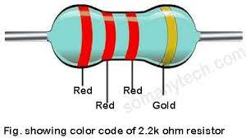
Resistor Color Code — Worked Examples
14

Slide 15
Five-Band and SMD Resistor Codes
Five-band precision: first three bands = significant digits, 4th = multiplier, 5th = tolerance
Military-spec five-band: 5th band indicates reliability (% change over 1000 hrs: brown = 1%, red = 0.1%, orange = 0.01%, yellow = 0.001%)
SMD three-digit code: first two digits = significant figures, last digit = multiplier
For values < 100 Ω, “R” replaces a digit as a decimal point (e.g., 1R0 = 1.0 Ω)
SMD four-digit code: first three = significant figures, last = multiplier
Extra letter may indicate tolerance (e.g., F = ±1%)
15

Slide 16
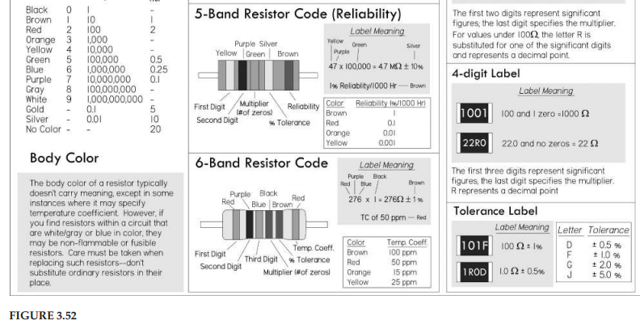
Five-Band and SMD Code Reference
16

Slide 17
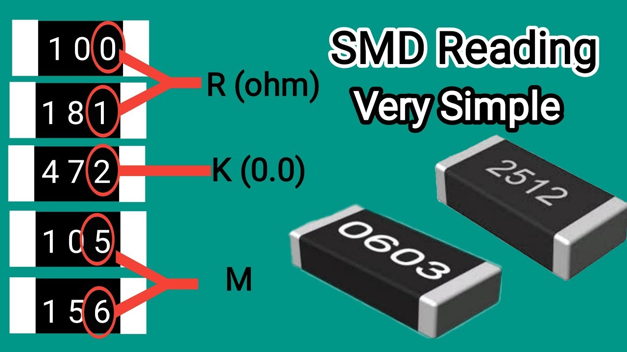
SMD Resistor Code Examples
17

Slide 18
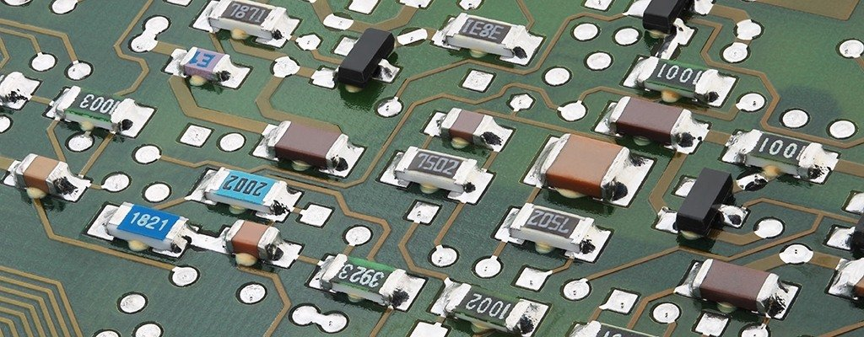
SMD Resistors on a Real PCB
18

Slide 19
Caution — Resistor Body Color
Body color usually does not carry significant meaning
Exception — white and blue body colors mark nonflammable and fusible resistors
These resistors are designed not to catch fire when they overheat
Fusible resistors cut current like a fuse when overheated
Never replace a white- or blue-bodied resistor with a normal resistor — fire hazard
19

Slide 20
PART 2
Real Resistor Characteristics
Selecting the right resistor for the job
20

Slide 21
Ideal vs. Real Resistors
Two primary selection criteria: nominal resistance value and power rating
Real resistors have non-ideal characteristics that vary across families
A resistor good for one application can be disastrous in another
Developing an acceptable tolerance requires understanding these non-ideal behaviours
Always consult the manufacturer’s data sheet for detailed specifications
21

Slide 22
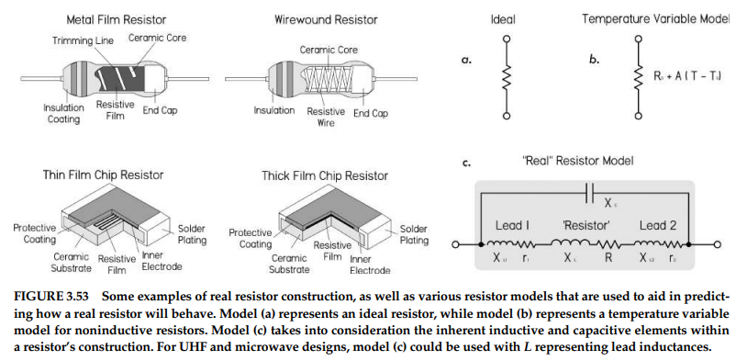
Real Resistor Construction and Models (Fig. 3.53)
22
FIGURE 3.53

Slide 23
Key Resistor Specifications
Voltage Rating — maximum voltage the resistor can withstand
Tolerance — allowable deviation from nominal value (e.g., ±1%, ±5%)
Power Rating — maximum power it can safely dissipate
Temperature Coefficient (TCR) — resistance change per degree of temperature
Frequency Response — how resistance changes at high frequencies
Noise — random voltage fluctuations generated by the resistor
Stability and Reliability — long-term drift and failure rate
23

Slide 24
Resistor Categories
Precision — low voltage/power coefficients, excellent stability, very low noise and reactance
Semiprecision — primarily for current-limiting or voltage-dropping; good long-term stability
General-Purpose — initial variation ~5%, up to ~20% under full power; higher noise; low cost
Power — for power supplies and control circuits; 5% stability acceptable; wirewound or film
24

Slide 25
PART 3
Capacitors
Energy storage, signal coupling, and filtering
25

Slide 26
What Is a Capacitor?
A device that stores energy in an electric field between two conductive plates
Major function: store charge from applied current and release it later as useful current
Charging and discharging rate can be controlled by a series resistor
Used in high-current discharge (photoflashes), memory backup, power supply smoothing
Also used to control IC timing and shape waveforms
26

Slide 27
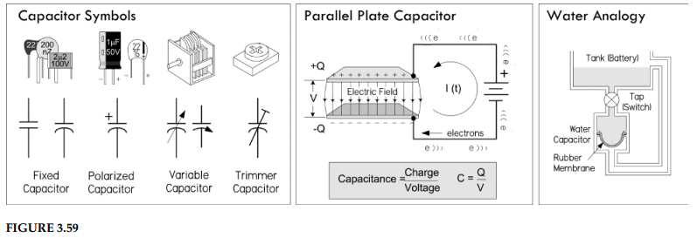
Capacitor Symbols, Structure, and Analogy (Fig. 3.59)
FIGURE 3.59
27

Slide 28
DC Blocking and AC Coupling
A capacitor in series with a signal path blocks DC while allowing AC to pass
At DC, a capacitor’s impedance is ideally infinite — no current flows
At AC frequencies, impedance becomes finite and decreases with increasing frequency
This couples two circuit stages without introducing unwanted DC shifts
Controls how much of a given frequency gets through — controls attenuation
28

Slide 29
Decoupling and Bypassing
A capacitor in parallel (to ground) acts as a decoupling capacitor
Allows DC to continue along the path while diverting high-frequency noise to ground
Bypassing: a capacitor across a circuit element diverts unwanted frequencies around it
Essential for removing noise and ripple from supply voltages
Without decoupling, sensitive circuits (especially digital logic ICs) tend to misbehave
Also used in passive/active filter networks, LC resonant circuits, and RC snubber circuits
29

Slide 30
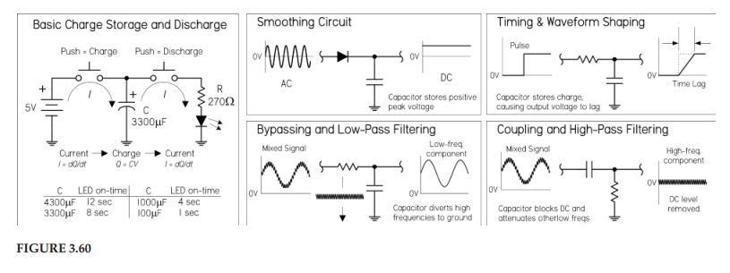
Capacitor Functions — Circuit Examples (Fig. 3.60)
30

Slide 31
Capacitance — The Fundamental Relationship
Q = C × V
Q = charge (coulombs), C = capacitance (farads), V = voltage (volts)
When a dc voltage V is applied across the leads of a capacitor, one of its “plates” charges up to a value of Q = CV, while the other plate will charge up to –Q
Capacitance measured in farads: 1 F = 1 C / 1 V
Once charged to near source voltage, no more DC current flows. The physical separation between plates prevents this
Typical values range from 1 pF (10⁻¹² F) to 68,000 µF (0.068 F)
Larger capacitance = more stored charge = longer current supply
31

Slide 32
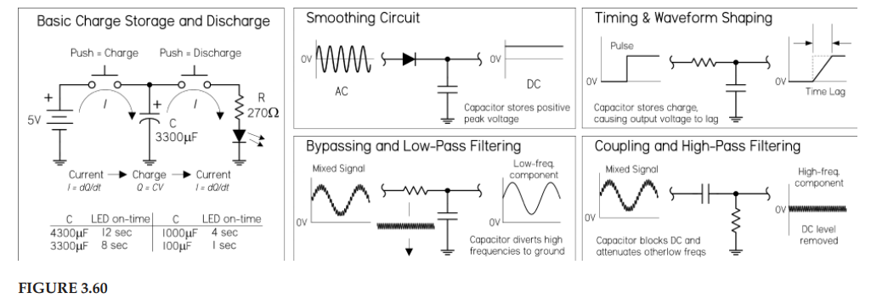
Charge Storage and LED On-Time Comparison
32

Slide 33
PART 4
Capacitors in Series & Parallel
Combining capacitors and their effects
33

Slide 34
Capacitors in Parallel
C_total = C1 + C2 + C3 + ...
Capacitances add directly — analogous to resistors in series
Intuitively: parallel capacitors increase total plate surface area
Maximum safe voltage is limited by the capacitor with the lowest rating
Both capacitance and voltage rating should be marked on schematics, but the voltage rating is often missing
34

Slide 35
Capacitors in Series
1/C_total = 1/C1 + 1/C2 + 1/C3 + ...
Total capacitance is less than the smallest individual capacitor
Calculated like resistors in parallel (reciprocal sum)
Useful when the group must withstand a larger voltage than any single capacitor
Trade-off: total capacitance decreases as voltage withstand increases
35

Slide 36
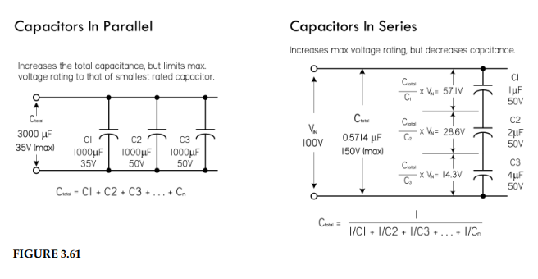
Capacitors in Parallel and Series — Circuits (Fig. 3.61)
36
FIGURE 3.61

Slide 37
Voltage Division Across Series Capacitors
Voltage does not divide equally — depends on capacitance values
Voltage across Cₙ: V_n = (C_total / C_n) × V_in
Smaller capacitance → larger voltage drop (inverse of resistor behaviour)
Equalizing resistors (~100 Ω/V of supply) across each capacitor reduce uneven division
With real capacitors, leakage resistance may dominate the voltage division
37

Slide 38
PART 5
RC Circuits and Reactance
Time-domain and frequency-domain behaviour
38

Slide 39
RC Time Constant — Charging
V(t) = Vs x ( 1 - e^(-t/RC) )
Without resistance, a capacitor charges or discharges almost instantaneously
Adding resistance produces an exponential charge/discharge rate (see Fig. 3.62)
τ = RC is the time constant (seconds); R in ohms, C in farads
At t = τ: capacitor reaches 63.2% of supply voltage
At t = 2τ: 86.5% | t = 3τ: 95.0% | t = 5τ: 99.2% (fully charged)
Charging is exponential — practically complete at 5τ
39

Slide 40
RC Time Constant — Discharging
V(t) = Vs x e^(-t/RC)
The inverse of the charging equation
At t = τ: voltage dropped by 63.2% (down to 36.8% of Vs)
At t = 5τ: considered fully discharged (down to 0.76% of Vs)
Applications: timing ICs, oscillators, waveform shapers, backup supplies
40

Slide 41
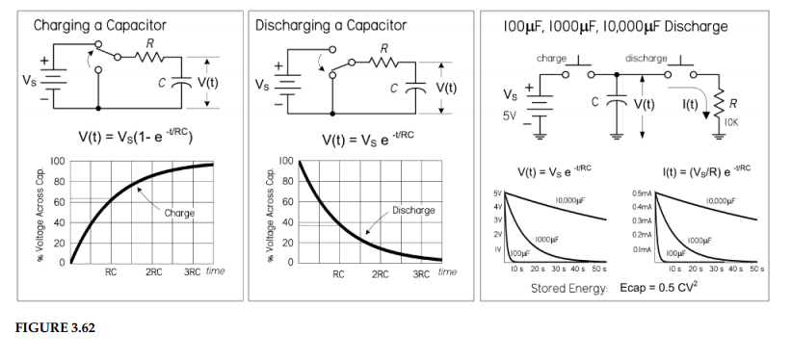
RC Circuit Behaviour (Fig. 3.62)
41
FIGURE 3.62

Slide 42
Worked Example — RC Time Constant
A 10 kΩ resistor charges a 47 µF capacitor from a 12 V supply. Find τ and V(τ).
Step 1: τ = R × C = 10,000 × 47 × 10⁻⁶ = 0.47 s
Step 2: V(τ) = 12 × (1 − e⁻¹) = 12 × 0.632 = 7.58 V
Step 3: Time to fully charge ≈ 5τ = 5 × 0.47 = 2.35 s
Step 4: At 5τ, V ≈ 12 × 0.9924 = 11.91 V — practically 12 V
42

Slide 43
Capacitive Reactance
Xc = 1 / (2πfC) = 1 / (ωC)
Charge stored is proportional to applied voltage and capacitance (Q = CV)
In AC circuits, current is proportional to voltage, capacitance, and frequency
Capacitance and frequency together produce a quantity analogous to resistance
Xc is capacitive reactance in ohms; f is frequency in Hz; C in farads
Reactance decreases with increasing frequency and/or capacitance
No actual power is dissipated — energy stored is returned each cycle
Over a complete cycle, average power is zero
Real capacitors deviate from the ideal curve due to parasitic effects
43

Slide 44
Worked Example — Capacitive Reactance
Find the reactance of a 220 pF capacitor at 10 MHz.
Step 1: Convert — C = 220 × 10⁻¹² F, f = 10 × 10⁶ Hz
Step 2: Xc = 1 / (2π × 10⁷ × 220 × 10⁻¹²)
Step 3: Xc = 1 / (2π × 2.2 × 10⁻³) = 1 / 0.01382 ≈ 72.3 Ω
At 10 MHz, this small capacitor presents relatively low impedance to AC signals
44

Slide 45
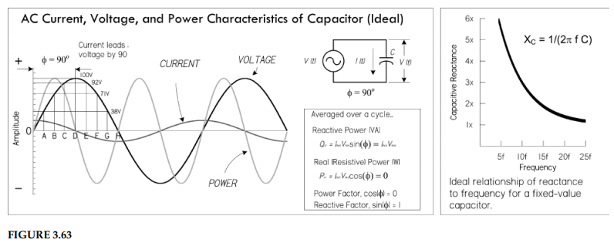
AC Characteristics and Reactance (Fig. 3.63)
45
FIGURE 3.63

Slide 46
PART 6
Real Capacitors
Parasitics, specifications, and selection
46

Slide 47
Real Capacitor Imperfections
Real capacitors contain parasitic effects that deviate from ideal behaviour
Four major non-ideal parameters:
Leakage (parallel resistance) — small DC current flows through the dielectric
Equivalent Series Resistance (ESR) — resistive losses in leads and plates
Equivalent Series Inductance (ESL) — inductive behaviour at high frequencies
Dielectric Absorption (DA) — ‘memory’ effect; voltage reappears after discharge
Construction determines which parasitics dominate — selection depends on application
47

Slide 48
Key Capacitor Specifications
DC Working Voltage (DCWV) — maximum voltage the capacitor can withstand
Dissipation Factor (DF) — ratio of energy lost to energy stored per cycle
Quality Factor (Q) — Q = Xc / ESR; higher Q means less loss (e.g., if a capacitor stores 1000 J and dissipates 2 J, Q = 500)
Heat conversion rate is proportional to power and frequency of applied energy
Dielectric loss is proportional to frequency and the loss tangent of the material
Temperature Coefficient (TC) — capacitance change per degree of temperature
Insulation Resistance (IR) — resistance of the dielectric material
IRMS — maximum RMS ripple current the capacitor can handle
48

Slide 49
Types of Capacitors
Electrolytic (Aluminum, Tantalum) — high capacitance, polarized; bulk energy storage
Ceramic (single-layer, multilayer) — small, low cost, wide frequency range
Film (polyester, polypropylene, polystyrene) — good stability, low loss
Mica (silver mica) — precision, very low loss, high frequency
Variable and Trimmer — adjustable capacitance for tuning circuits
Supercapacitors (ultracapacitors) — very high capacitance for energy storage
Other: vacuum, air core, oil-filled, and metallized film capacitors
49

Slide 50
Reading Capacitor Labels
Many labeling schemes: color bands, number/letter combinations, or direct markings
Labels may indicate capacitance, tolerance, temperature coefficient, voltage rating
Three-digit code common: first two digits significant, third is multiplier (in pF)
Example: 104 = 10 × 10⁴ pF = 100,000 pF = 100 nF = 0.1 µF
Always verify both capacitance and voltage rating before installation
50

Slide 51
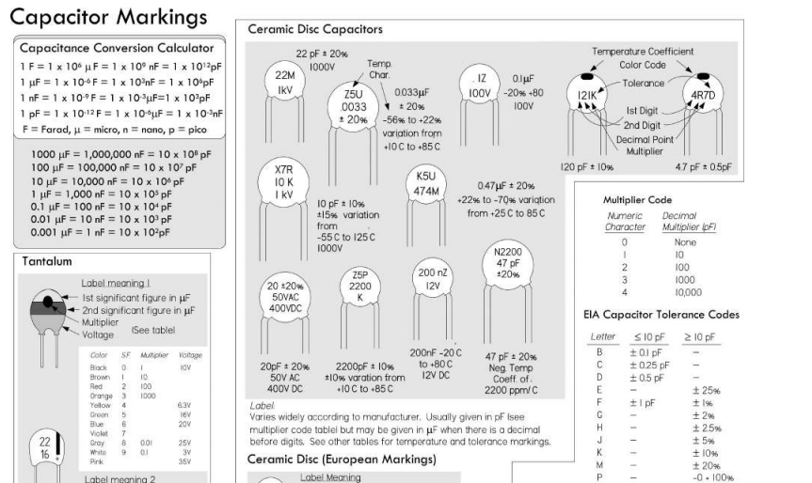
Capacitor Markings (Fig. 3.66)
51
FIGURE 3.66

Slide 52
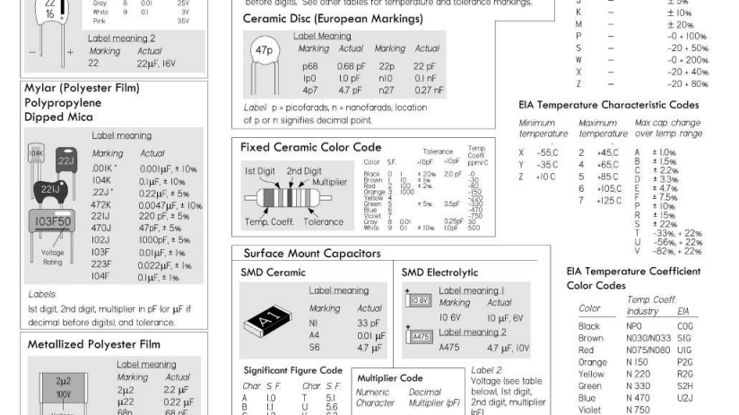
Capacitor Markings (continued)
52

Slide 53
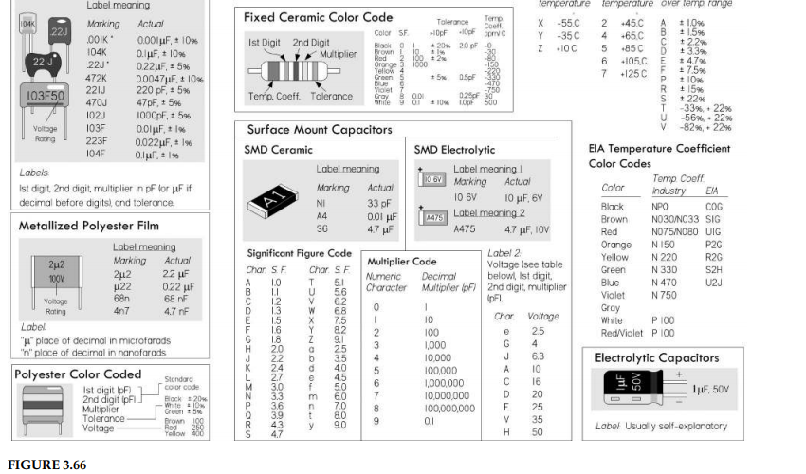
Capacitor Markings (continued)
53

Slide 54
End of Lecture
Questions?
54

